Slide 1
FACULTY OF SCIENCES

Slide 2
Biochemistry & -technology
WE09-10-14
846 members
Geology
WE13
100 members
Geography
WE12
120 members
WE
Mathematics, Computer Science
WE01-02-16
139 members
Physics
WE04-05
258 members
Chemistry
WE06-07
360 members
Biology
WE11
324 members

Slide 3
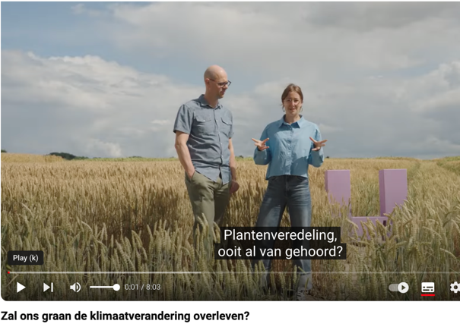
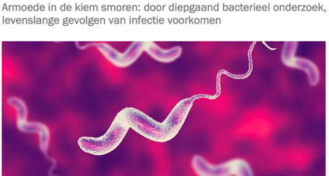
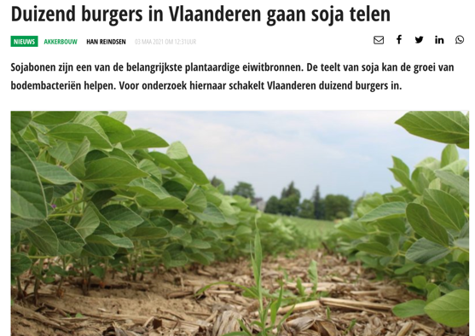
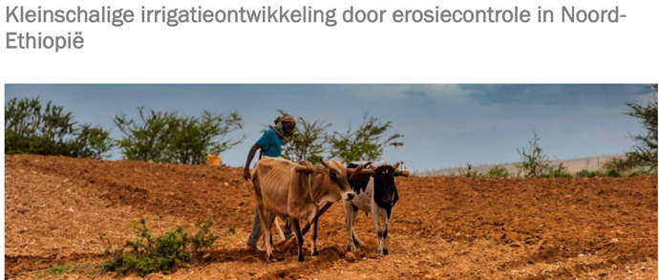

Slide 4
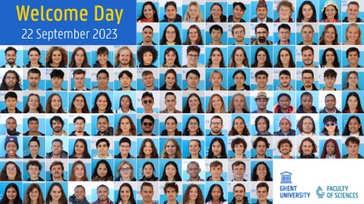
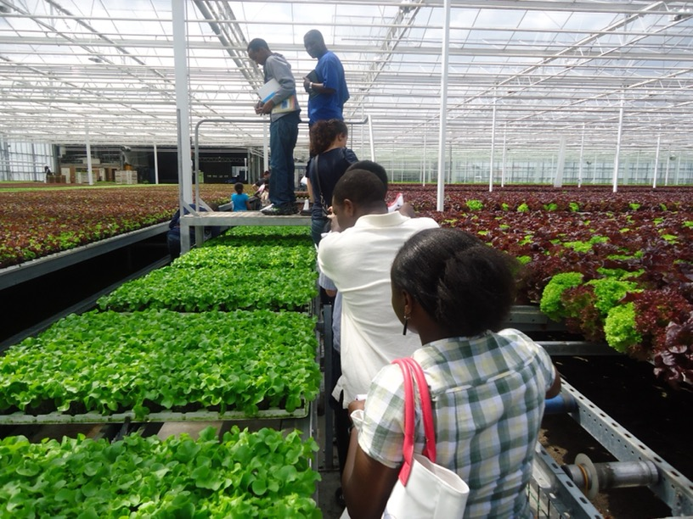
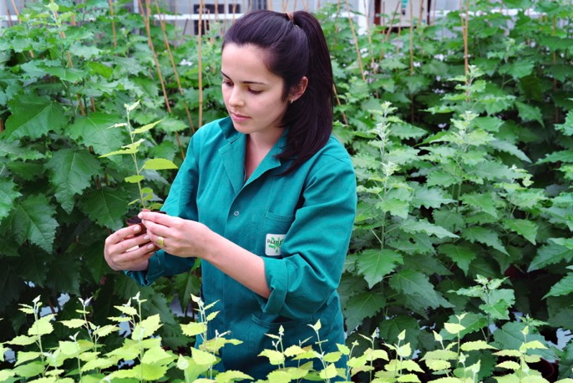
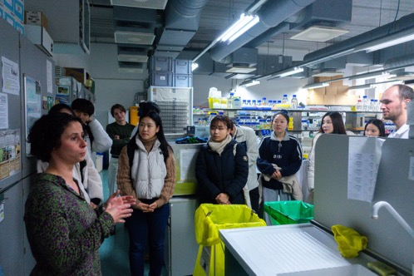

Slide 5
Dean: isabel.vandriessche@ugent.be
Hatim.elsghiar@ugent.be; decanaat.we@ugent.be
Director of Studies: dominique.adriaens@ugent.be
Charlotte.devolder@ugent.be
Director of research: veerle.cnudde@ugent.be
Roman.roobroeck@ugent.be
International Office: Anja Sandrap & Regine Coolen international.sci@ugent.be

