Slide 1


De code
Universiteit Gent
Vlaamse Overheid
Rotary Gent
Minerva Award
Vlaanderen Digitaal Award
Rotary Science Award
2018
2022
2024
gekra
akt!
team Dodona
Peter Dawyndt
Bart Mesuere
Charlotte Van Petegem
Rien Maertens
Niko Strijbol
Jorg Van Renterghem
dodona.be
@DodonaEdu
dodona@ugent.be

Slide 2


Slide 3


Slide 4
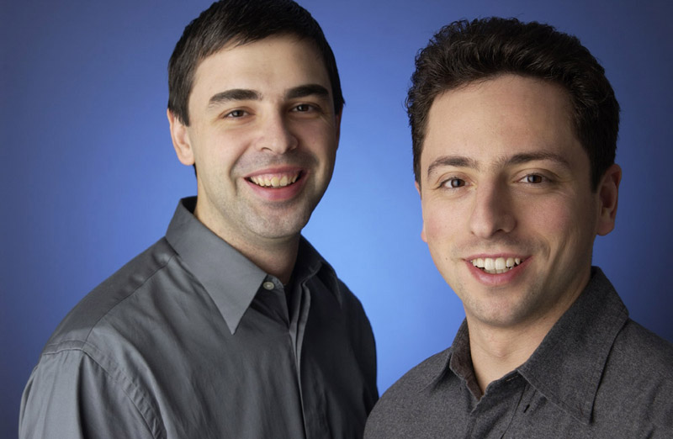

Slide 5
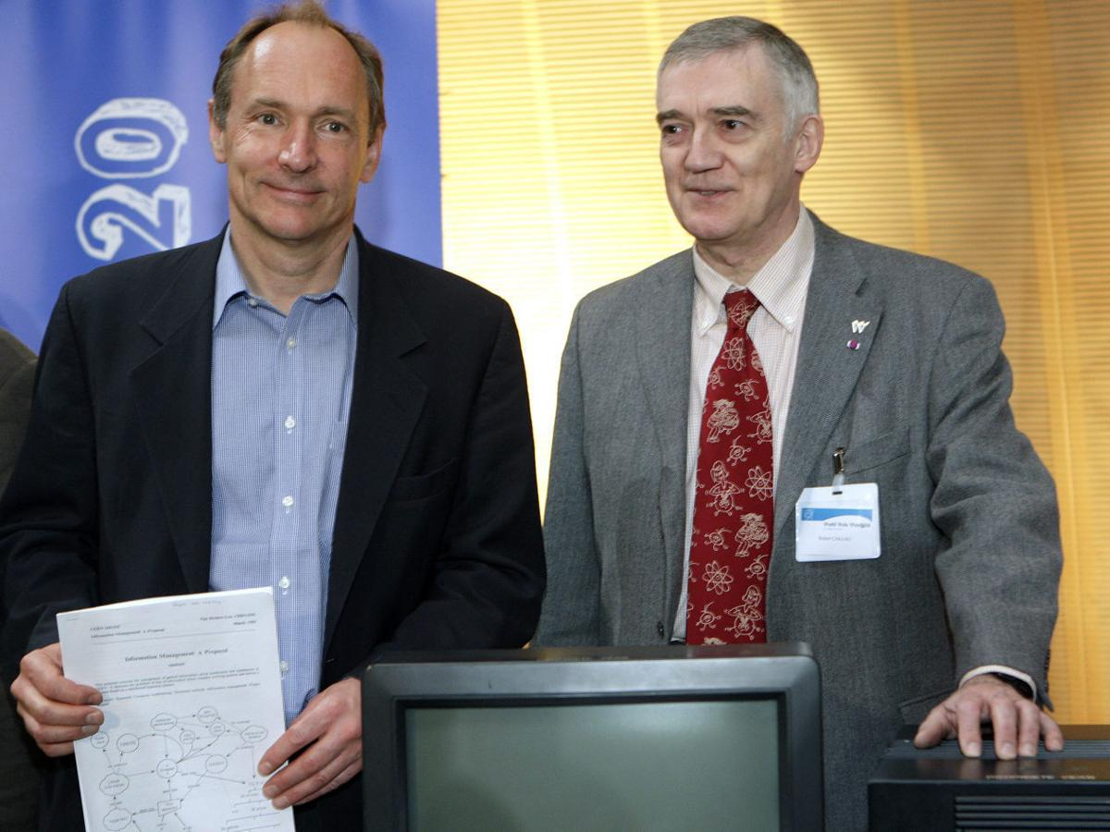

Slide 6
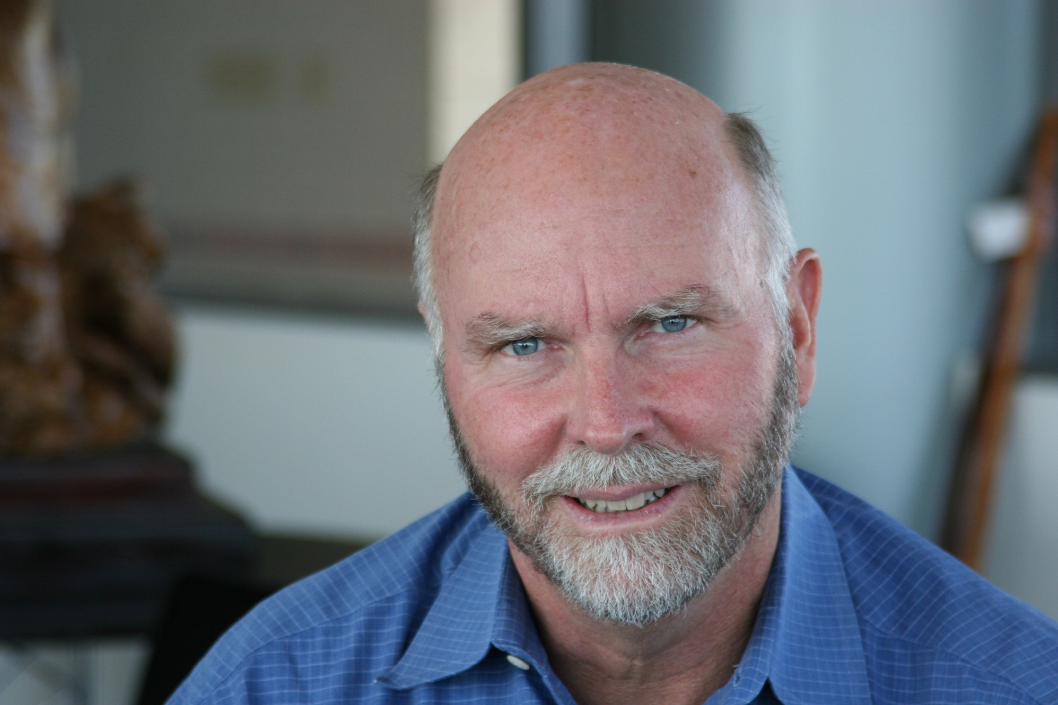
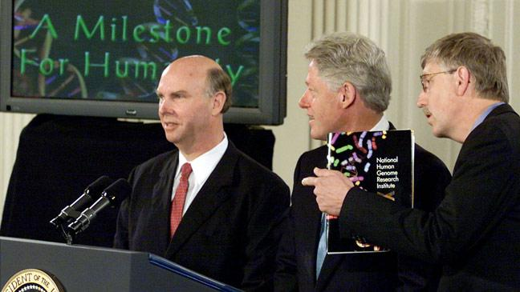

Slide 7
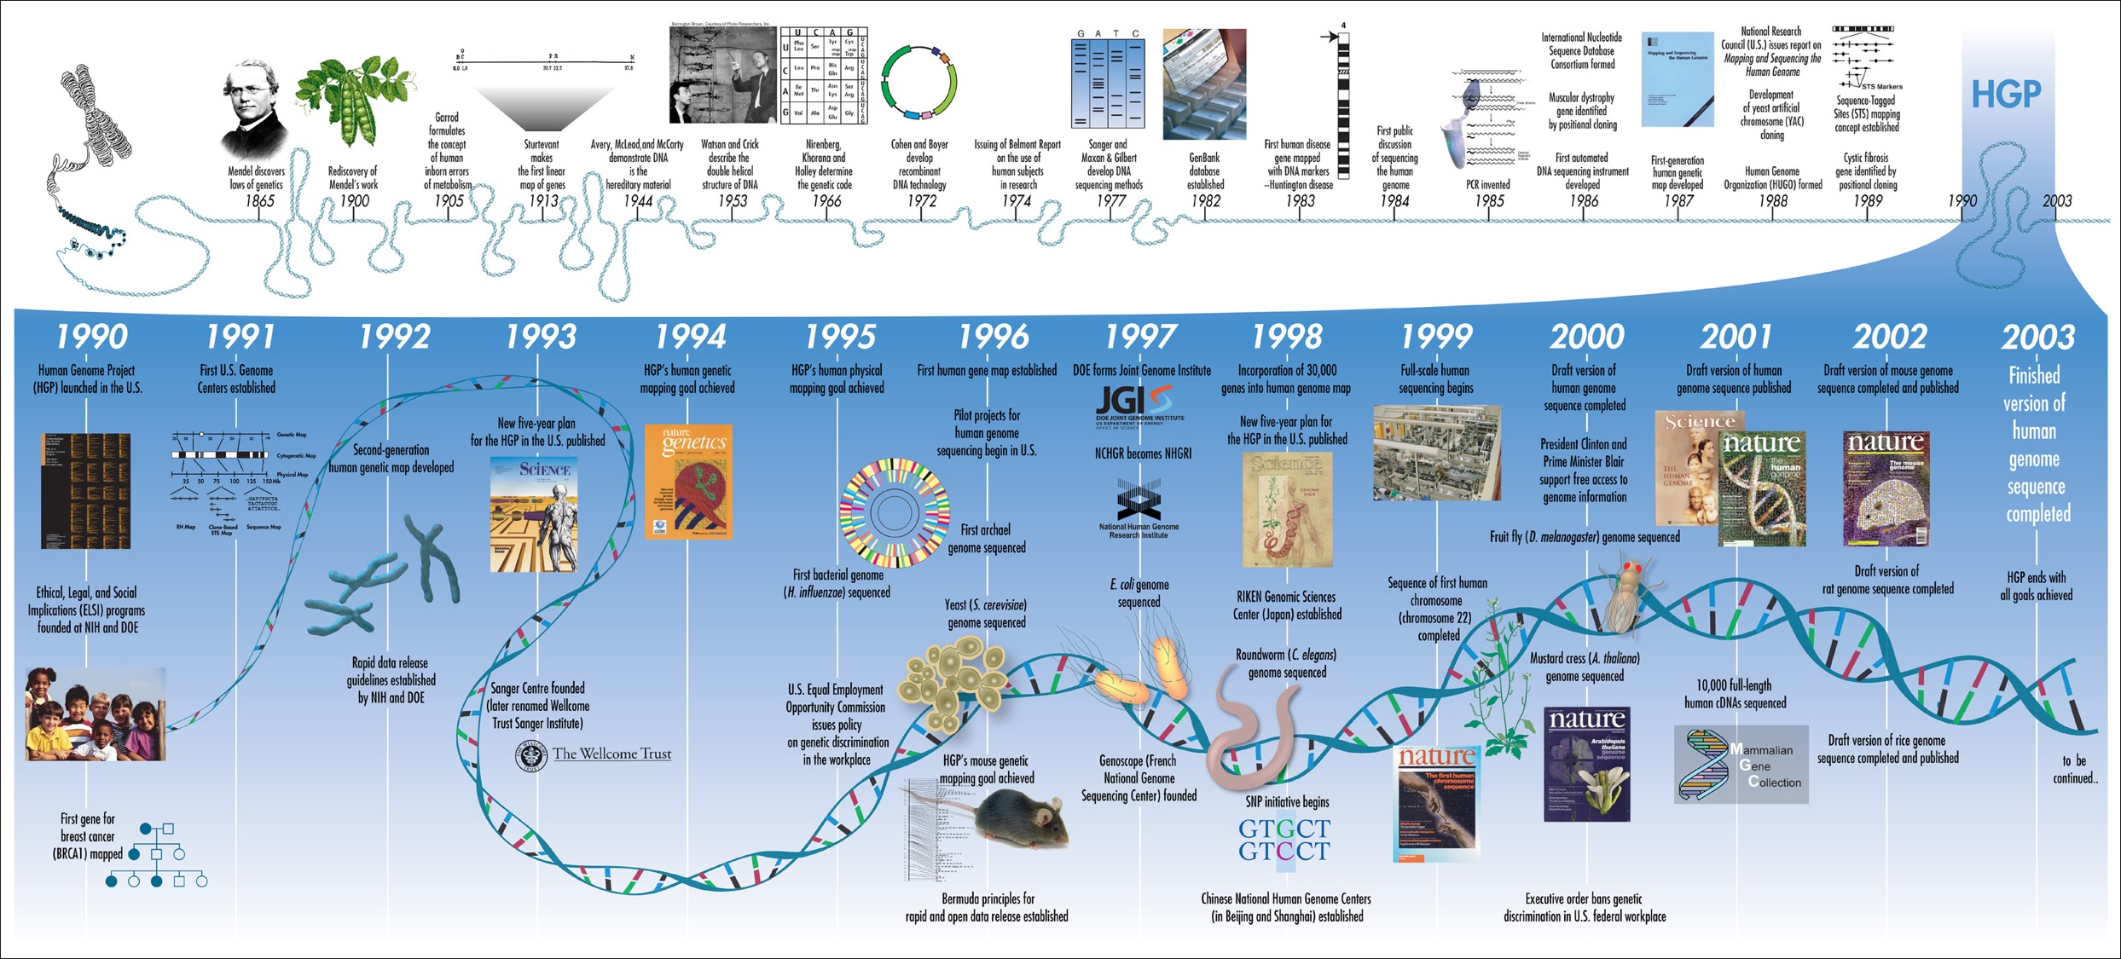
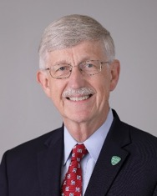
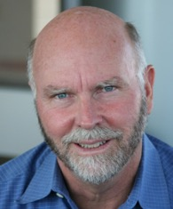
1990
The public Human Genome Project aims to sequence the human genome by 2005.
1997
Found Celera Genomics, a private company, with the same goal.
Francis Collins
Craig Venter
Collins F.S. et al. (2003). Nature 422, 835-847.

Slide 8
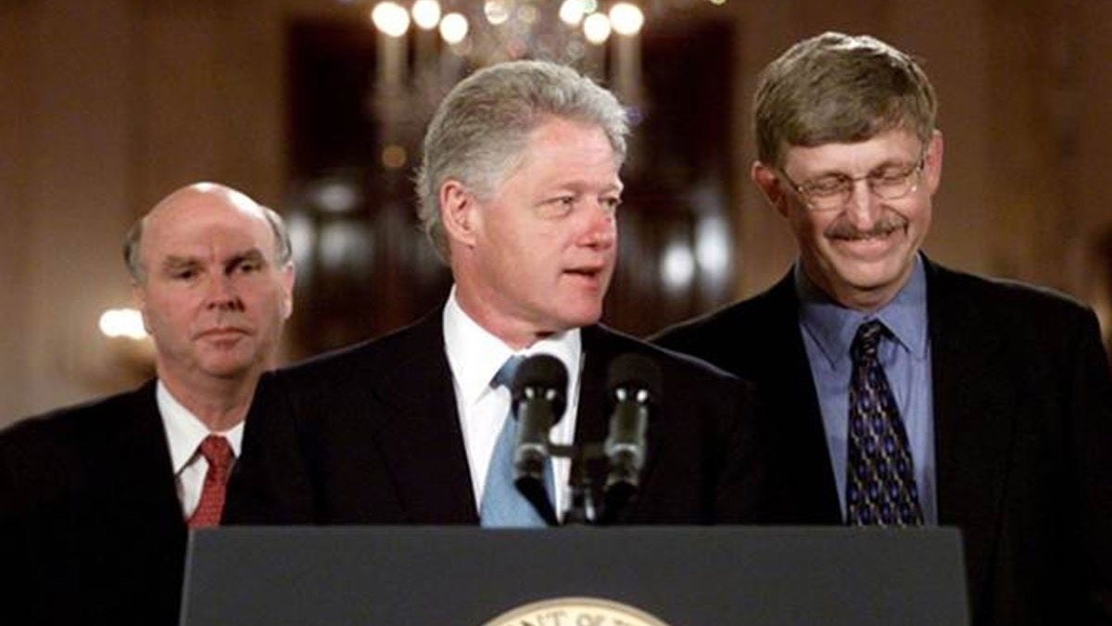

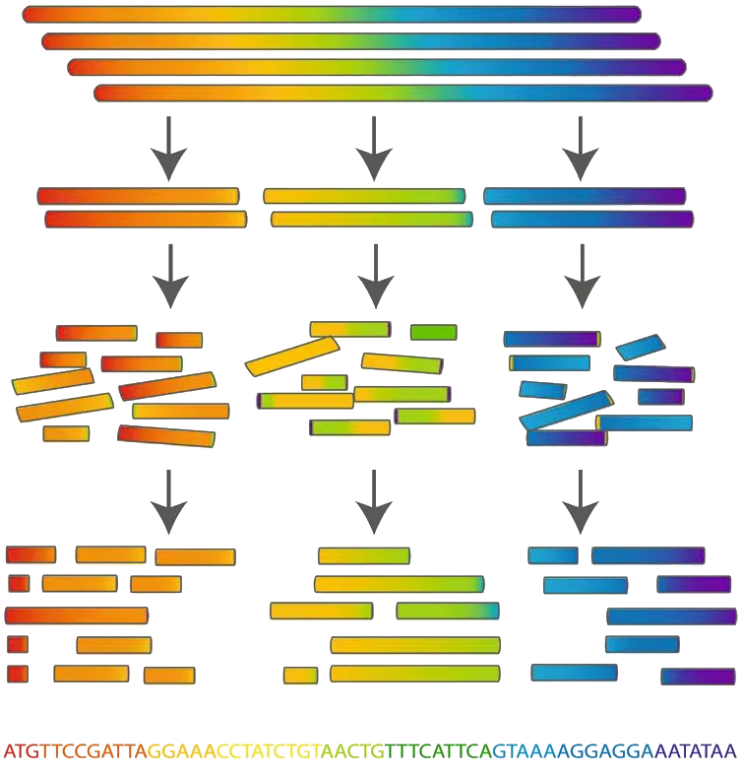
hierarchical shotgun sequencing
public Human Genome Project (HUGO)
cloned genomes
genomes divided into large segments of known order
ordered genome segments
multiple genome portions are sheared into variable sized segments
unordered sequenced segments
computational automated assembly
resulting overlapping sequence segments (the higher the coverage the better the quality of the sequencing)
overlapping sequence segments combined to construct the genome consensus

Slide 9
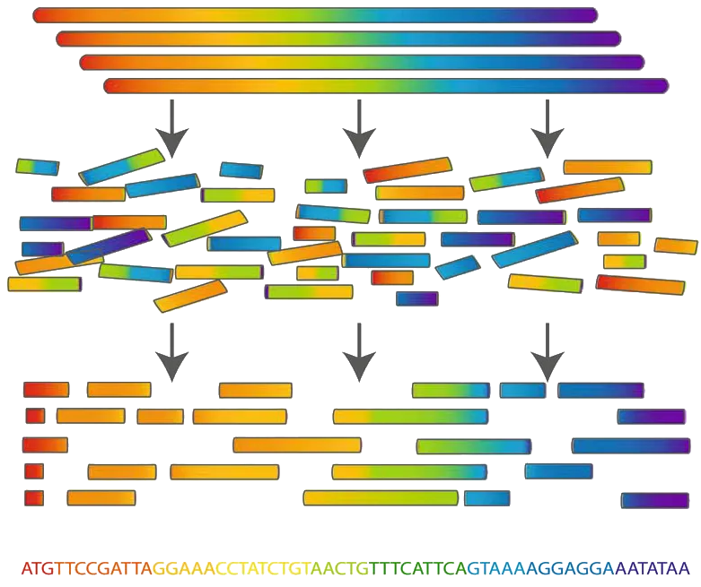
whole genome shotgun (WGS) sequencing
private Human Genome Project (Celera)
cloned genomes
multiple genomes are sheared into variable sized segments
unordered sequenced segments
computational automated assembly
resulting overlapping sequence segments (the higher the coverage the better the quality of the sequencing)
overlapping sequence segments combined to construct the genome consensus

Slide 10
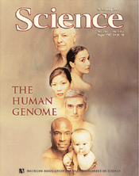
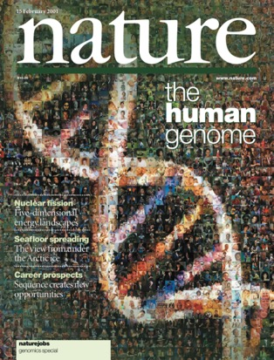

Slide 11




DNA
RNA
PROTEINE

Slide 12
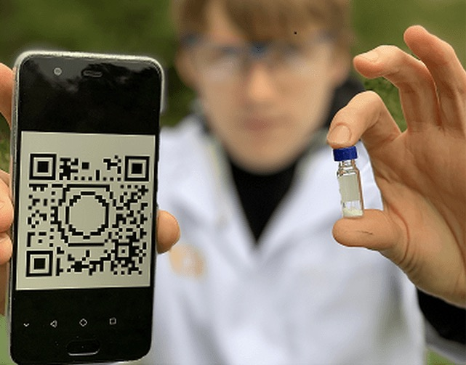

Martens S, Landuyt A, Espeel P, Devreese B, Dawyndt P, Du Prez F (2018). Multifunctional sequence-defined macromolecules for chemical data storage. Nature communications 9(1), 1-8.

Slide 13





Slide 14


Slide 15


Slide 16


Why learning to code is so damn hard?

Slide 17
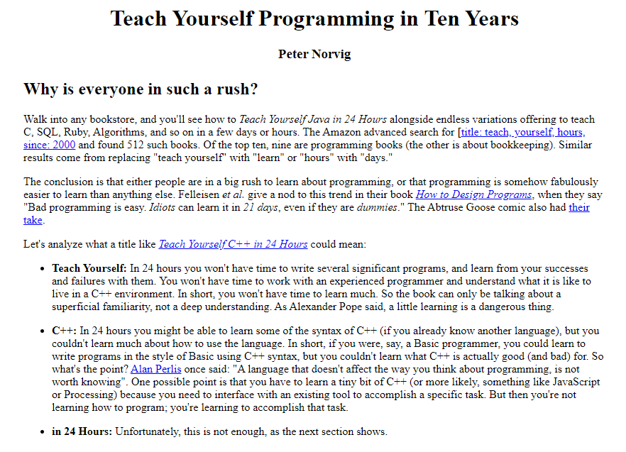

Slide 18
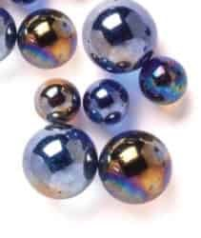


Slide 19
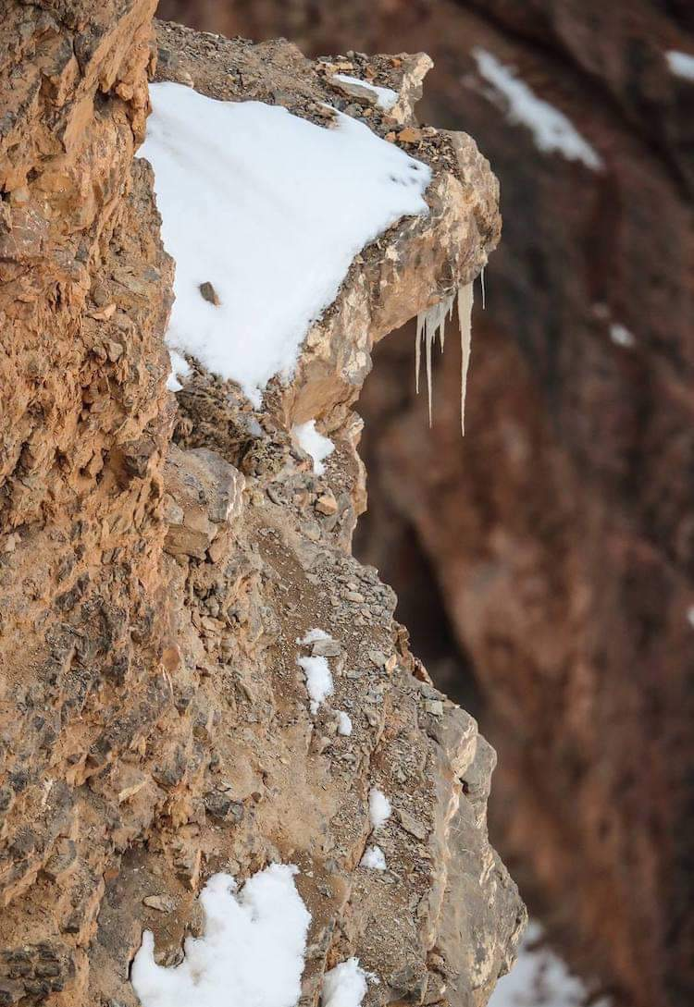
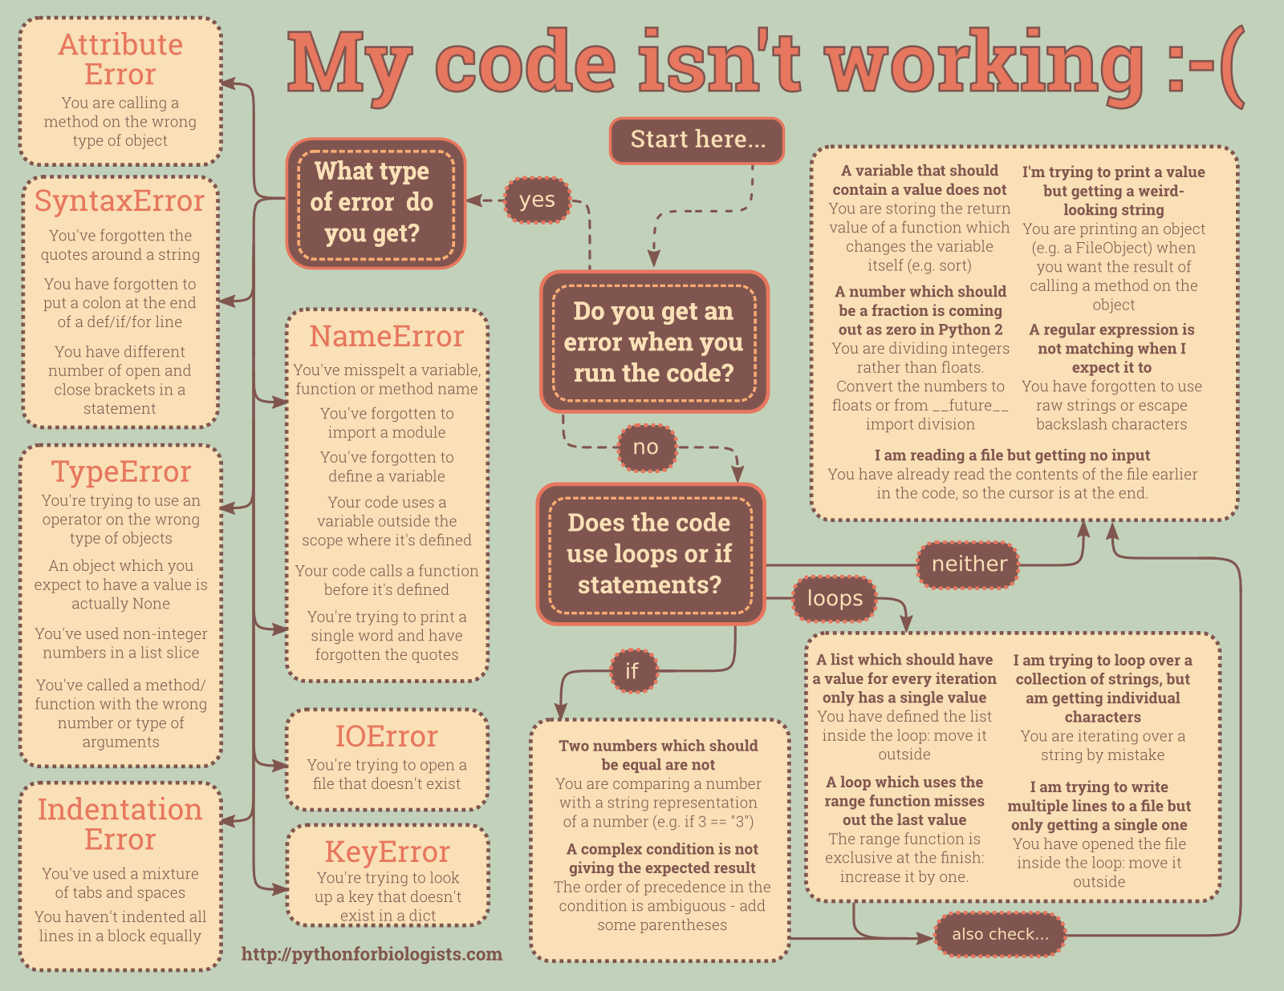

Slide 20
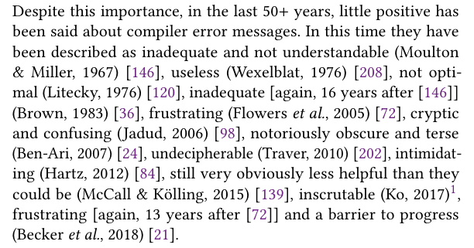

Slide 21
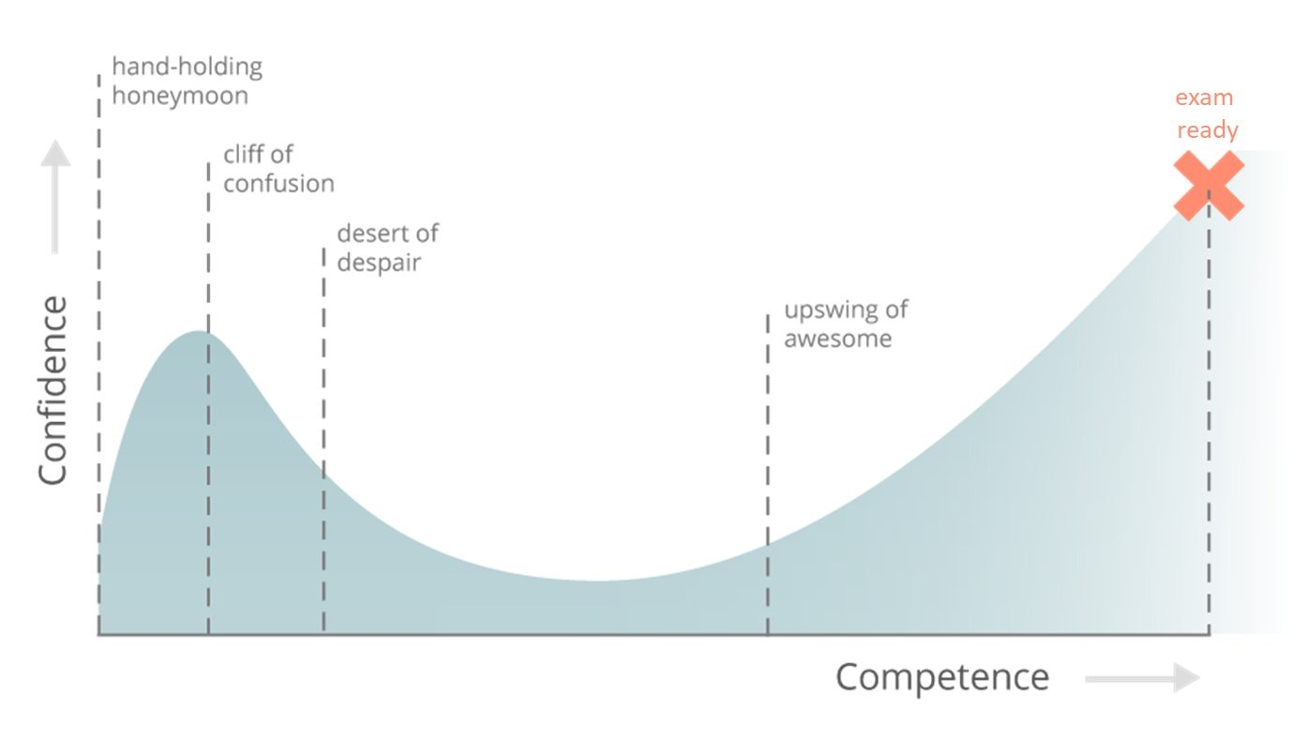

Slide 22
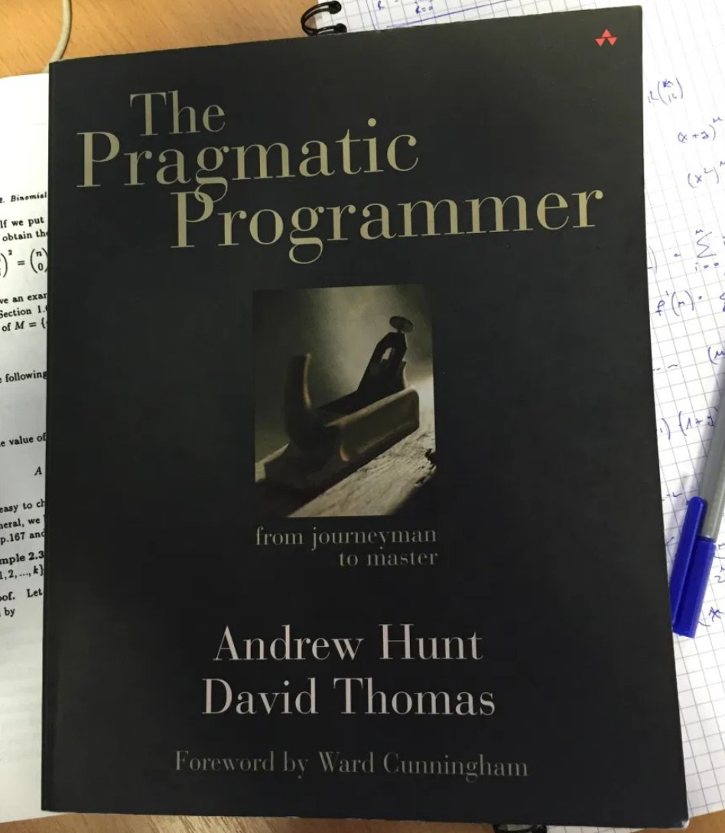

Slide 23
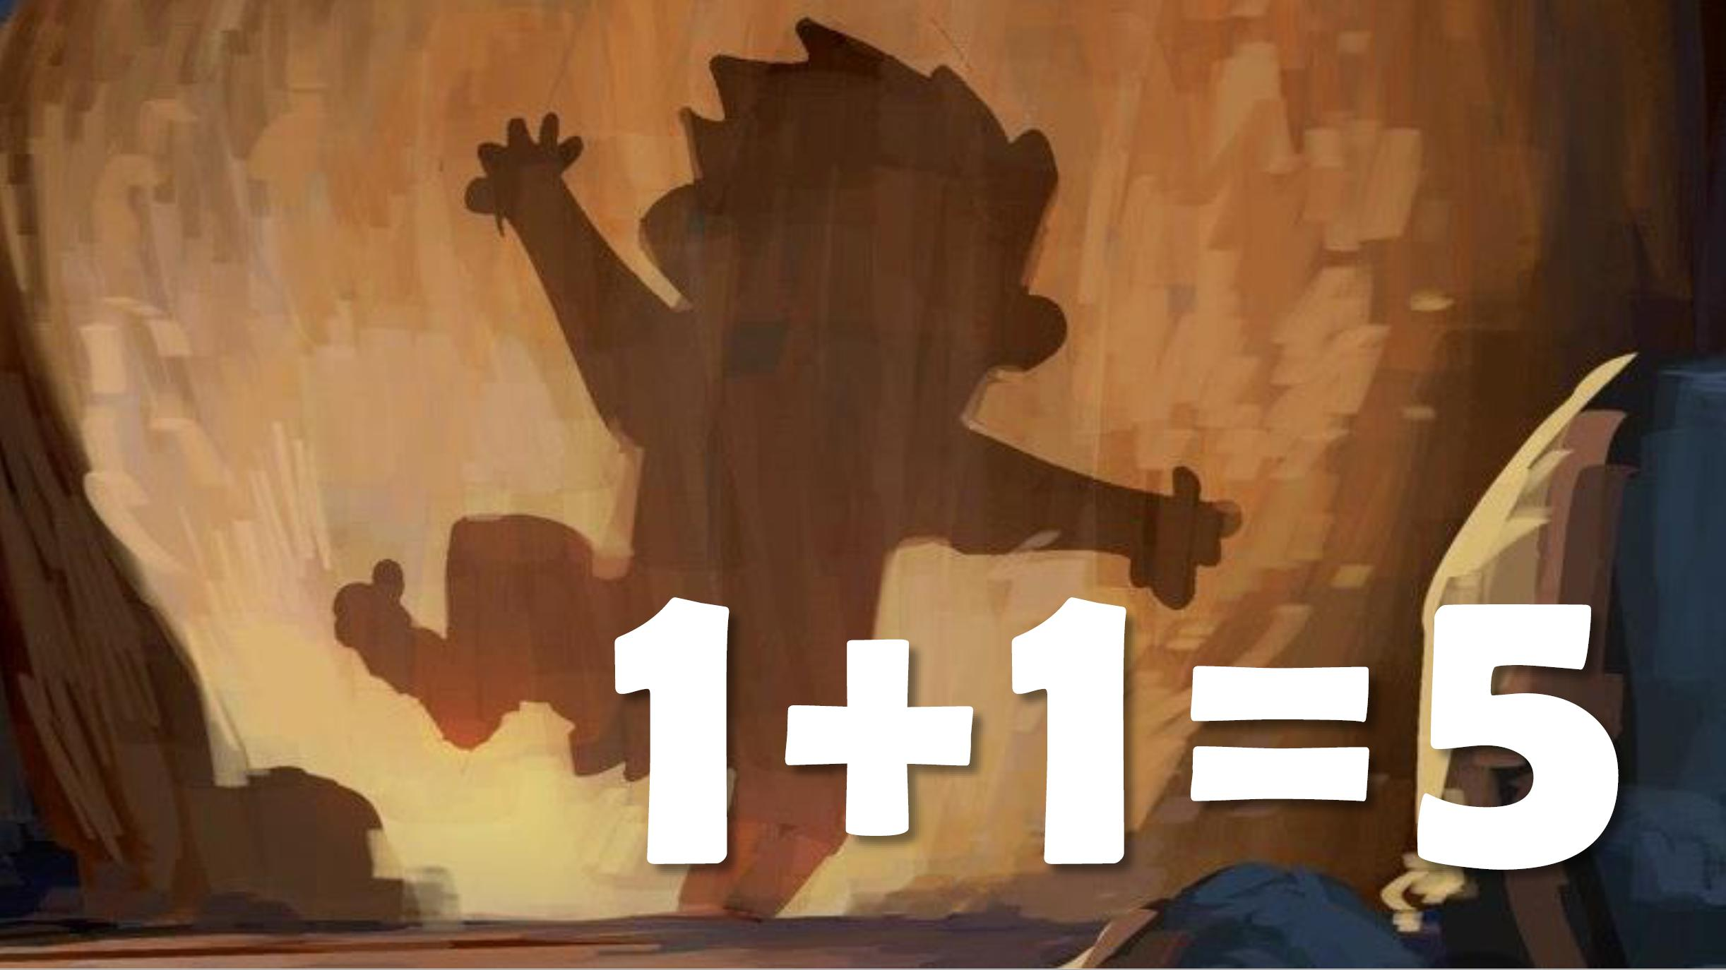

Slide 24
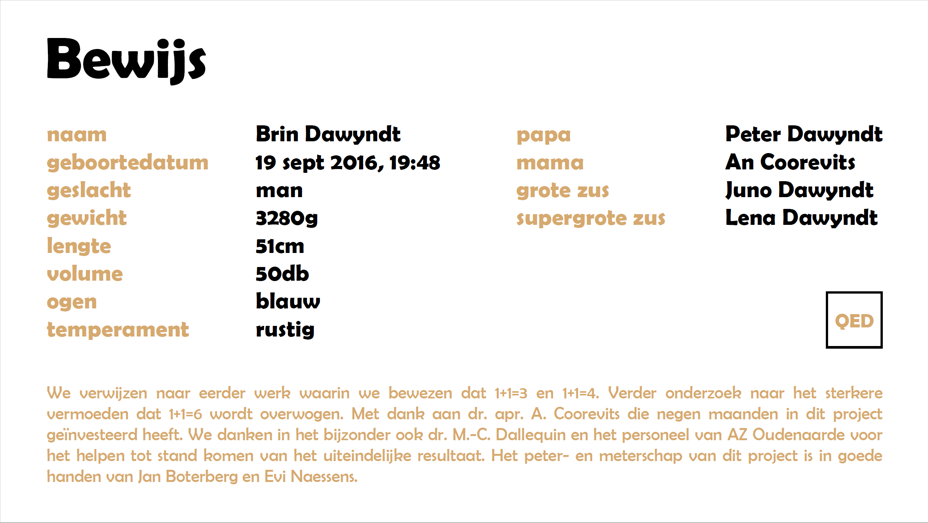

Slide 25
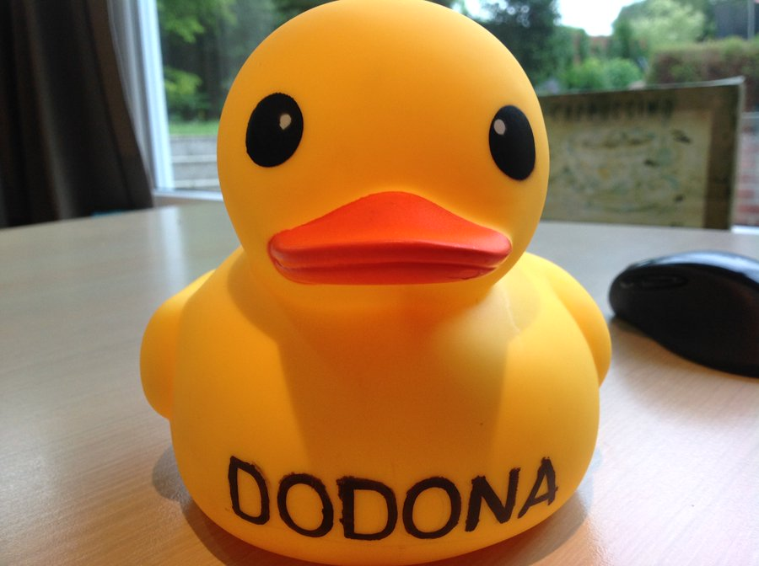

Slide 26
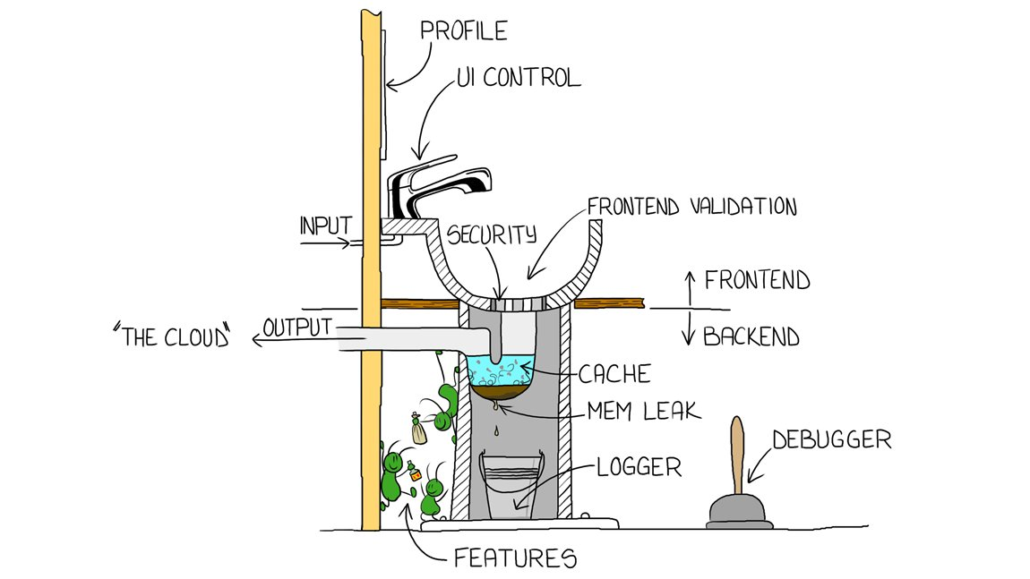

Slide 27

dodona.be
online leeromgeving ( intelligent tutoring system )
leren programmeren (meerdere programmeertalen / aspecten)
real-time feedback ( automated assessment )
zelf content toevoegen en delen ( community platform )
gratis
open source

Slide 28





69 364
05/05/2024
gebruikers
1 771
scholen
17 857 784
oplossingen
17 280
oefeningen

Slide 29
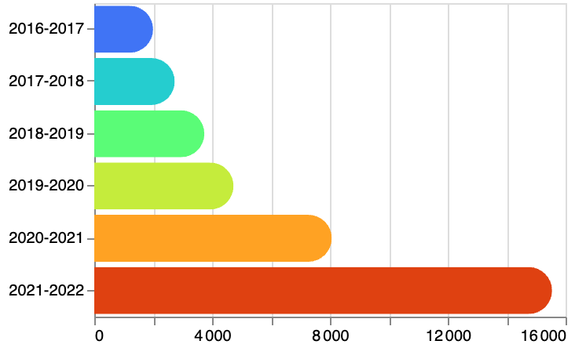
actieve gebruikers per academiejaar
actieve gebruikers

Slide 30

financiële steun
Universiteit Gent
Vlaamse Overheid (voorsprongfonds)
Fonds Wetenschappelijk Onderzoek – Vlaanderen (FW0)
Europese Commissie (ELIXIR)
UGent datacenter
Johan Van Camp & team
UGent Data Protection Office
Hanne Elsen & team
ontwikkelaars Dodona (studenten & lesgevers informatica)
Winnie De Ridder, Tibo D’hondt, Lucianos Lionakis, Felix Van der Jeugt, Mathieu Coussens, Pieter De Clercq,
Timon De Backer, Ilion Beyst, Dieter Mourisse, Brecht Willems, Robbert Gurdeep Singh, Louise Deconick,
Tim Ramlot, Bram Devlaminck, Freya Van Speybroeck, Toon Baeyens, Jeroen Tiebout, Anton Kindt
ontwikkelaars judges
Dieter Mourisse, Niels Neirynck, Felix Van der Jeugt, Christophe Scholliers, Pieter Verschaffelt,
Pieter De Clercq, J. Steegmans, Robbert Gurdeep Singh, Viktor Verstraelen, Gust Bogaert, Koen Plevoets,
Maarten Vandercammen, Elisa Gonzalez Boix, Boris Sels, Mathijs Saey, Stijn De Clercq, Quinten Vervynck, Brecht Willems, Tim Ramlot
ontwikkelaars IDE plugins
Pieter De Clercq, Tobiah Lissens, Stijn De Clercq, Mathijs Saey
auteurs programmeeroefeningen
<een schier eindeloze lijst>

Slide 31

team Dodona
Peter Dawyndt
Bart Mesuere
Charlotte Van Petegem
Rien Maertens
Niko Strijbol
Jorg Van Renterghem
dodona.be
@DodonaEdu
dodona@ugent.be

Slide 32
Dodona
Universiteit Gent
Vlaamse Overheid
Rotary Gent
Minerva Award
Vlaanderen Digitaal Award
Rotary Science Award
2018
2022
2024
learn to code with a virtual co-teacher that supports active learning
team Dodona
Peter Dawyndt
Bart Mesuere
Charlotte Van Petegem
Rien Maertens
Niko Strijbol
Jorg Van Renterghem
dodona.be
@DodonaEdu
dodona@ugent.be

